Slide 1

Uninformed Search
Chapter 3
Some material adopted from notes by Charles R. Dyer, University of Wisconsin-Madison

Slide 2
Today’s topics
Goal-based agents
Representing states and actions
Example problems
Generic state-space search algorithm
Specific algorithms
Breadth-first search
Depth-first search
Uniform cost search
Depth-first iterative deepening

Slide 3
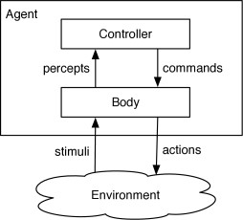
Agent Design
“Sensors”
“Actions”

Slide 4
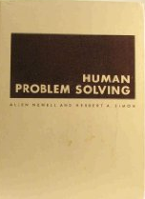
AI as a Search Problem
Allen Newell and Herb Simon, the problem space principle in AI:
"The rational activity in which people engage to solve a problem can be described in terms of :
a set of states of knowledge,
operators for changing one state into another,
constraints on applying operators, and
control knowledge for deciding which operator to apply next."
Newell A & Simon H A. Human problem solving. Englewood Cliffs, NJ: Prentice-Hall. 1972.

Slide 5
Graphs
A graph G = (E, V)
V = set of vertices (nodes)
E = set of edges between pairs of nodes, (𝑥, 𝑦)
G can be:
Undirected: order of (𝑥, 𝑦) doesn’t matter
– These are symmetric
Directed: order of (𝑥, 𝑦) does matter
Weighted: cost function 𝑔(𝑥, 𝑦)

Slide 6
Undirected Graph
A graph G = (E, V)
V = set of vertices (nodes)
E = set of edges between pairs of nodes
a
c
V= { ??? }
E = { ??? }
b

Slide 7
Undirected Graph
A graph G = (E, V)
V = set of vertices (nodes)
E = set of edges between pairs of nodes
a
c
V= { a, b, c }
E = { (a, c), (c, a), (b, c) ,(c,b)}
b

Slide 8
Directed Graph
A graph G = (E, V)
V = set of vertices (nodes)
E = set of edges between pairs of nodes
a
c
V= { ??? }
E = { ??? }
b

Slide 9
Directed Graph
A graph G = (E, V)
V = set of vertices (nodes)
E = set of edges between pairs of nodes
a
c
V= { a, b, c }
E = { (a, c), (b, c) }
b

Slide 10
Weighted Graph
A graph G = (E, V)
V = set of vertices (nodes)
E = set of edges between pairs of nodes
4
V= { ??? }
E = { ??? } g = ???
a
c
5
b
1

Slide 11
Weighted Graph
A graph G = (E, V)
V = set of vertices (nodes)
E = set of edges between pairs of nodes
V= { a, b, c }
E = { (a,c), (b, c), (c, b) }
g = {(a, c): 4, (b, c): 5, (c, b): 1}
4
a
c
5
b
1

Slide 12
Some Key Terms: States, Goal, and Solution
State: a representation of the current world/environment (as needed for the agent)
Initial State: The state the agent/problem starts in
Goal State: The desired state
Solution: a sequence of actions that operate sequentially on states and allow the agent to achieve its goal

Slide 13
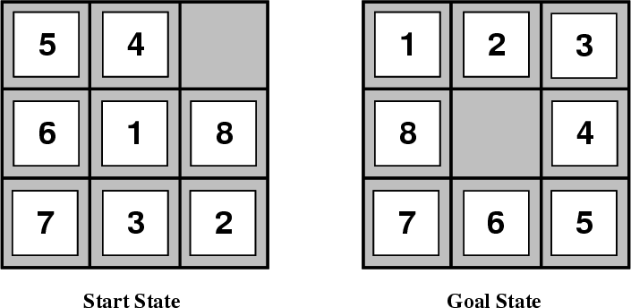
Example: 8-Puzzle
Given an initial configuration of 8 numbered tiles on a 3x3 board, move the tiles to produce a desired goal configuration

Slide 14
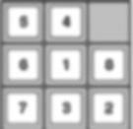
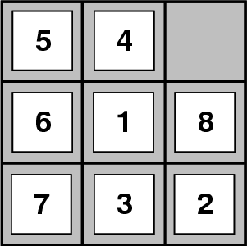
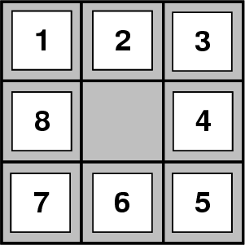

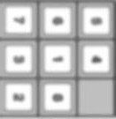
Building goal-based agents
–How do we represent the state of the “world”?
–What is the goal and how can we recognize it?
–What are the possible actions?
initial state
goal state

Slide 15
Representing states
State of an 8-puzzle?

Slide 16
Representing states
State of an 8-puzzle?
A 3x3 array of integer in {0..8}
No integer appears twice
0 represents the empty space
In Python, we might implement this using a nine- character string: “540681732”
And write functions to map the 2D coordinates to an index

Slide 17

What’s the goal to be achieved?
Describe situation we want to achieve, a set of properties that we want to hold, etc.
Defining a goal test function that when applied to a state returns True or False
For our problem:
def isGoal(state):
return state == “123405678”

Slide 18

What are the actions?
Primitive actions for changing the state In a deterministic world: no uncertainty in an action’s effects (simple model)
Action should specify:
can action be applied to the current state
What state results after action is performed

Slide 19
Representing actions
Actions for 8-puzzle?
Number of actions/operators depends on the
representation used in describing a state
Specify 4 possible moves for each of the 8 tiles, resulting in a total of 4*8=32 operators
Or: Specify four moves for “blank” square and we only need 4 operators
Representational shift can simplify a problem!

Slide 20
Representing actions
Actions ideally considered as discrete events
that occur at an instant of time
action:goToSchool
State:atHome
State:atSchool

Slide 21
Finding optimal solution = Searching in a Graph
State:atHome
1
State:atSchool
action:
goToSchool
2
action:enroll
action:enroll
State:EnrolledIn441
State:EnrolledIn441
action:Learn
3
action:Learn
State:LearnDAA
State:LearnAI

Slide 22
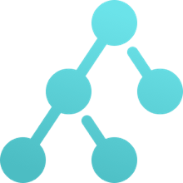
Problem Size
Size of a problem usually described in terms of possible number of states
Tic-Tac-Toe has about 3⁹ states (19,683≈2*10⁴)
Checkers has about 10⁴⁰ states
Rubik’s Cube has about 10¹⁹ states
Chess has about 10¹²⁰ states in a typical game
– Go has 2*10¹⁷⁰
Theorem provers may deal with an infinite space
State space size ≈ solution difficulty

Slide 23
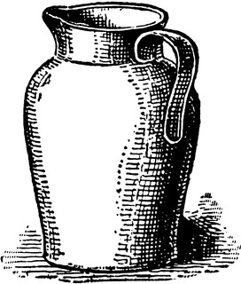

Water Jug Problem
Problem Space:
Two jugs J1 & J2
Capacity C1 & C2 respectively
Initial State:
J1 has W1 water and J2 has W2 water
Actions:
Pour from jug X to jug Y until X empty or Y full
Empty jug X onto the floor
Goal State:
J1 has G1 water and J2 G2

Slide 24
Search in a state space
Basic idea:
–Create representation of initial state
–Try all possible actions & connect states that result
–Recursively apply process to the new states until we find a solution or dead ends
We need to keep track of the connections between states and might use a
– Tree data structure or
– Graph data structure
A graph structure is best in general…

Slide 25
Formalizing state space search
A state space is a graph (V, E) where V is a set of nodes and E is a set of arcs, and each arc is directed from a node to another node
Nodes: data structures with state description and other info, e.g., node’s parent, name of action that generated it from parent, etc.
Arcs: instances of actions, head is a state, tail is the state that results from action

Slide 26
Formalizing search in a state space
Each arc has fixed, positive cost associated with it corresponding to the action cost
Each node has a set of successor nodes corresponding to all legal actions that can be applied at node’s state
One or more nodes are marked as start nodes
A goal test predicate is applied to a state to determine if its associated node is a goal node

Slide 27
Water Jug Problem
Problem Space:
Two jugs J1 & J2
Capacity C1 & C2 respectively
Initial State:
J1 has W1 water and J2 has W2 water
Actions:
Pour from jug X to jug Y until X empty or Y full
Empty jug X onto the floor
Goal State:
J1 has G1 water and J2 G2

Slide 28
Example: Water Jug Problem
5
2
Action table
Given full 5-gal. jug and empty 2-gal. jug, fill 2-gal jug with one gallon
State = (x,y), where x is water in jug 1; y is water in jug 2
Initial State = (5,0)
Goal State = (-1,1), where
-1 means any amount
Name | Cond. | Transition | Effect

Slide 29
Example: Water Jug Problem
5
2
Action table
Given full 5-gal. jug and empty 2-gal. jug, fill 2-gal jug with one gallon
State = (x,y), where x is water in jug 1; y is water in jug 2
Initial State = (5,0)
Goal State = (-1,1), where
-1 means any amount
Name | Cond. | Transition | Effect
dump1 | x>0 | (x,y)→(0,y) | Empty Jug 1
dump2 | y>0 | (x,y)→(x,0) | Empty Jug 2
pour_1_2 | x>0 & y<C2 | (x,y)→(x-D,y+D) D = min(x,C2-y) | Pour from Jug 1 to Jug 2
pour_2_1 | y>0 & X<C1 | (x,y)→(x+D,y-D) D = min(y,C1-x) | Pour from Jug 2 to Jug 1

Slide 30
Formalizing search
Solution: sequence of actions associated with a path from a start node to a goal node
Solution cost: sum of the arc costs on the solution path
If all arcs have same (unit) cost, then solution cost is length of solution (number of steps)

Slide 31
State-space search algorithm
;; problem describes the start state, operators, goal test, and operator costs
;; queueing-function is a comparator function that ranks two states
;; general-search returns either a goal node or failure
function general-search (problem, QUEUEING-FUNCTION)
nodes = MAKE-QUEUE(MAKE-NODE(problem.INITIAL-STATE))
loop
if EMPTY(nodes) then return "failure"
node = REMOVE-FRONT(nodes)
if problem.GOAL-TEST(node.STATE) succeeds
then return node
nodes = QUEUEING-FUNCTION(nodes, EXPAND(node,
problem.OPERATORS))
end
;; Note: The goal test is NOT done when nodes are generated
;; Note: This algorithm does not detect loops

Slide 32
Key procedures to be defined
EXPAND
Generate a node’s successor nodes, adding them to the graph if not already there
GOAL-TEST
Test if state satisfies all goal conditions
QUEUEING-FUNCTION
Maintain ranked list of nodes that are candidates for expansion
Changing definition of the QUEUEING-FUNCTION leads to different search strategies

Slide 33
Informed vs. uninformed search
Uninformed search strategies (blind search)
Use no information about likely direction of a goal
Methods: breadth-first, depth-first, depth-limited, uniform-cost, depth-first iterative deepening, bidirectional
Informed search strategies (heuristic search)
Use information about domain to (try to) (usually) head in the general direction of goal node(s)
Methods: hill climbing, best-first, greedy search, beam search, algorithm A, algorithm A*
Notes:
Heuristic = “rule of athumb”

Slide 34
Evaluating search strategies
Completeness
Guarantees finding a solution whenever one exists
Time complexity (worst or average case)
Usually measured by number of nodes expanded
Space complexity
Usually measured by maximum size of graph/tree during the search
Optimality/Admissibility
If a solution is found, is it guaranteed to be an optimal one, i.e., one with minimum cost

Slide 35
Classic uninformed search methods
The four classic uninformed search methods
Breadth first search (BFS)
Depth first search (DFS)
Uniform cost search (generalization of BFS)
Iterative deepening (blend of DFS and BFS)
To which we can add another technique
Bi-directional search (hack on BFS)

Slide 36
Breadth-First Search
Queue Contents:
V0
V1, V4
V4, V3
V3
V6, V5
V5
Empty
V₀
V₂
V₁
V₄
V₆
V₃
V₅

Slide 37
Breadth-First Search
Enqueue nodes in FIFO (first-in, first-out) order
Complete
Optimal : finds shortest path, which is optimal if all operators have same cost
Exponential time and space complexity, O(b^{d}), where d is depth of solution; b is branching factor (i.e., # of children)
Takes a long time to find solutions with large number of steps because must explore all shorter length possibilities first

Slide 38
Depth-First Search
Stack Contents:
V0
V4, V1
V4, V3
V4, V6, V5
V4, V6
V4
Empty
V₀
V₂
V₁
V₄
V₆
V₃
V₅
A traversal processes only those vertices that can be reached from the start vertex.

Slide 39
Depth-First (DFS)
Enqueue nodes on nodes in LIFO (last-in, first-out) order, i.e., use stack data structure to order nodes
May not terminate w/o depth bound
Not complete (with or w/o cycle detection, with or w/o a cutoff depth)
Exponential time, O(b^{d}), but linear space, O(bd)
Can find long solutions quickly if lucky (and short solutions slowly if unlucky!)

Slide 40
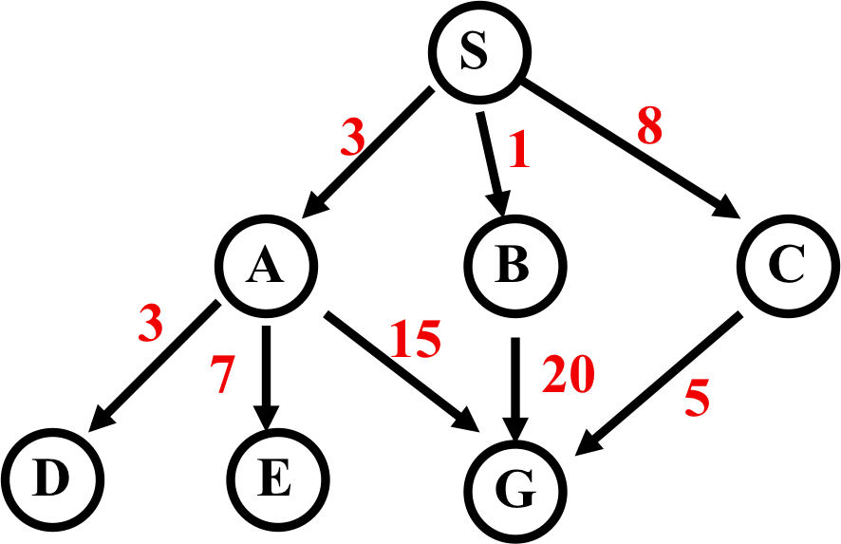
Uniform-Cost Search
Expanded node Nodes list
{ S⁰ }
S⁰ { B¹ A³ C⁸ }
B¹ { A³ C⁸ G²¹ }
A³ { D⁶ C⁸ E¹⁰ G¹⁸ G²¹ }
D⁶ { C⁸ E¹⁰ G¹⁸ G²¹ }
C⁸ { E¹⁰ G¹³ G¹⁸ G²¹ }
E¹⁰ { G¹³ G¹⁸ G²¹ }
G¹³ { G¹⁸ G²¹ }
Solution path found is S C G, cost 13

Slide 41
Uniform-Cost Search (UCS)
Enqueue nodes by path cost. i.e., let g(n) = cost of path from start to current node n. Sort nodes by increasing value of g(n).
Also called Dijkstra’s Algorithm
Complete
Optimal/Admissible
Exponential time and space complexity, O(b^{d})

Slide 42
Depth-First Iterative Deepening (DFID)
Iteratively increase depth cutoff:
Do DFS to depth 0, then (if no solution) DFS to depth 1, etc.
Complete
Optimal/Admissible if all operators have unit cost, else finds shortest solution (like BFS)
Time complexity a bit worse than BFS or DFS
Nodes near top of search tree generated many times, but since almost all nodes are near tree bottom, worst case time complexity still exponential, O(b^{d})

Slide 43
Depth-First Iterative Deepening (DFID)
Linear space complexity, O(bd), like DFS
Has advantages of BFS (completeness) and DFS (i.e., limited space, finds longer paths quickly)
Preferred for large state spaces where solution depth is unknown

Slide 44
How they perform
Depth-First Search:
4 Expanded nodes: S A D E G
Solution found: S A G (cost 18)
Breadth-First Search:
7 Expanded nodes: S A B C D E G
Solution found: S A G (cost 18)
Uniform-Cost Search:
7 Expanded nodes: S A D B C E G
Solution found: S C G (cost 13)
Only uninformed search that worries about costs
Iterative-Deepening Search:
10 nodes expanded: S S A B C S A D E G
Solution found: S A G (cost 18)

Slide 45
Searching Backward from Goal
Usually a successor function is reversible
i.e., can generate a node’s predecessors in graph
If we know a single goal (rather than a goal’s properties), we could search backward to the initial state
It might be more efficient
Depends on whether the graph fans in or out

Slide 46
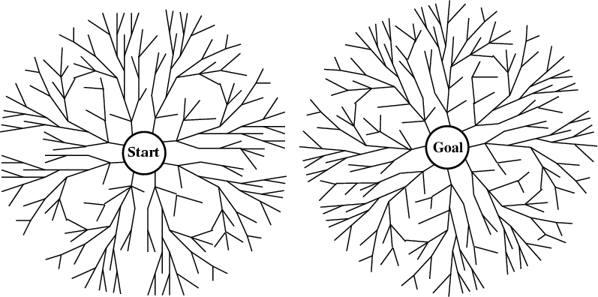
Bi-directional search
Alternate searching from the start state toward the goal and from the goal state toward the start
Stop when the frontiers intersect
Works well only when there are unique start & goal states
Requires ability to generate “predecessor” states
Can (sometimes) lead to finding a solution more quickly

